Slide 1
The Forecasting Demand for E-Commerce based on Large Number of Time Series
Eun Woo Son Jyotshana Paudyal Prakash Paudyal Raju Ghimire
Time Series Report

Slide 2
Introduction
We have used real E-Commerce data from tophairwigs.com
Data
Bigcommerce
Google Analytics
Google Adwords
Weekday Performance
Sales Improvement
First Attempt
Use Raw daily revenue data
Second Attempt
Use Summarised Monthly revenue data

Slide 3
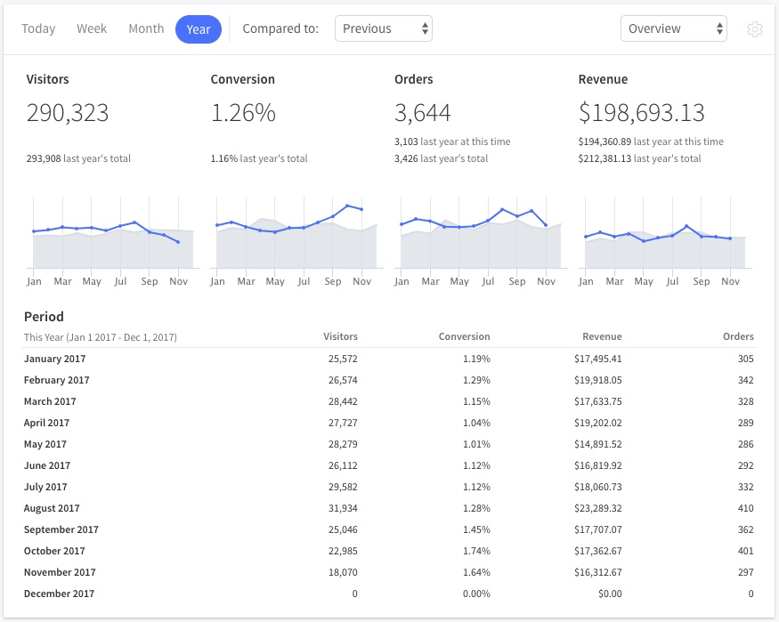
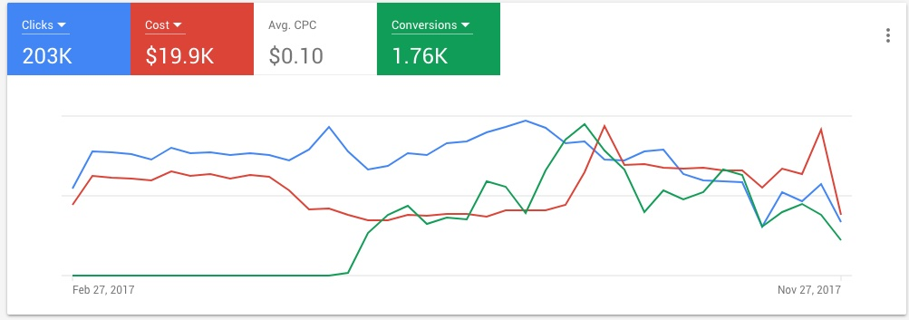
Bigcommerce & Google Adwords

Slide 4
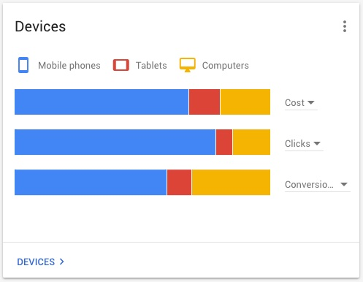
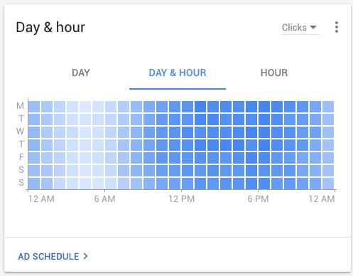

Slide 5
Data
Our data set is collected from official website of TopHairWigs.com (2014-2017)
Data contains information about Advertisement Clicks, Advertisement Costs, revenue
Businesses across the world are reviewing their businesses strategies and allocating a large portion of their budget and resources on their online operations. Similarly, a lot of retail stores are moving towards e-commerce. To analyze the different aspects of e-commerce, we chose to analyze the e-commerce data

Slide 6
Google Analytics
Our website use google analytics which use AdWords to advertise to target their online campaign
Ad Clicks
total number of times users have clicked on an ad to reach the property.
Ad Costs
derived cost for the advertising campaign. The cost of ad Click is linked with AdWords account.
Revenue-per-click,
the average revenue (from ecommerce sales and/or goal value) we received for each click on one of the search ads.

Slide 7
Objective
The objective of this analysis is to
explore the effect of advertisement on the number of visitors on an e-commerce website and its conversion rate to increase the revenue.
We are interested in finding certain periods of time where businesses can allocate more effort to advertise a product and reduce advertisement on certain period of month to reduce the advertisement cost.
This analysis is intended to help in making different campaign strategies so that online stores can increase the sales revenue with minimum advertisement cost.

Slide 8
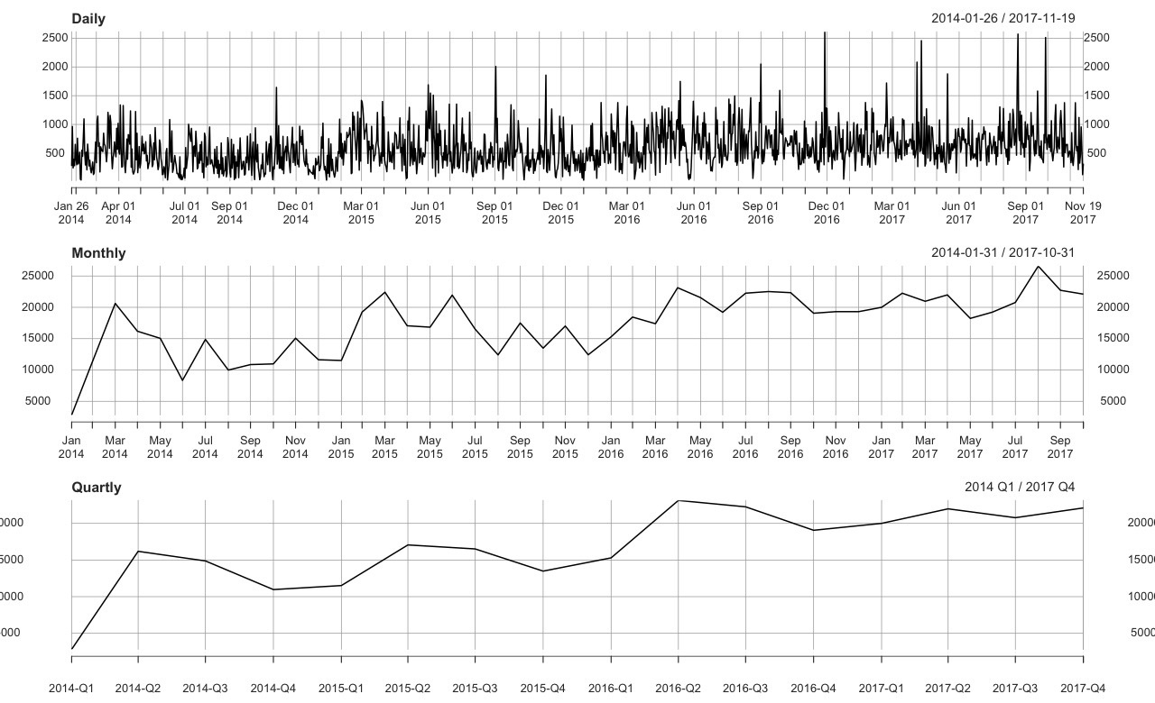

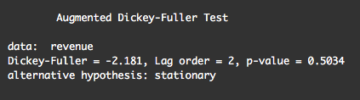
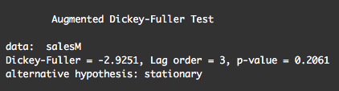
t

Slide 9
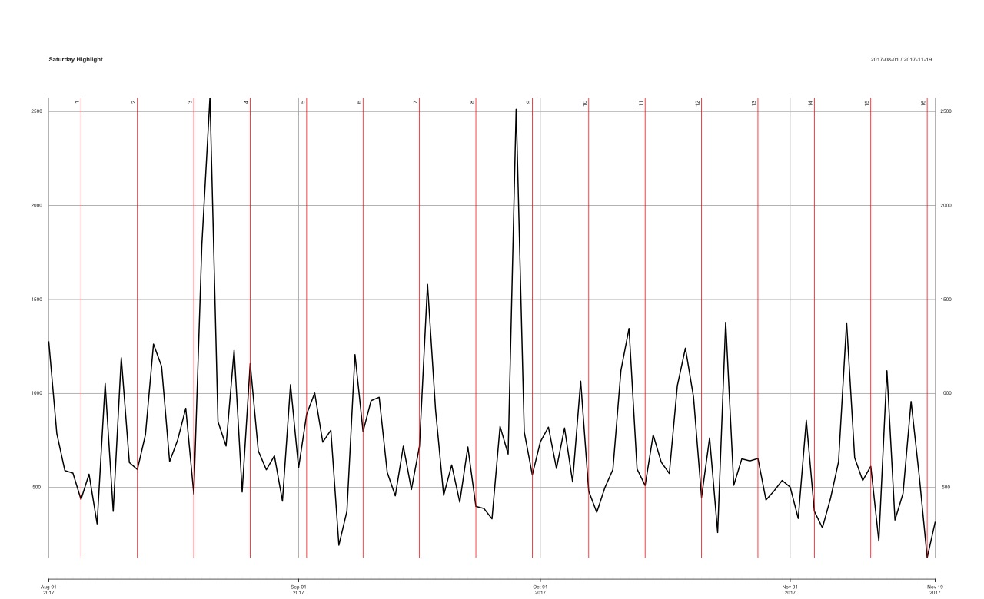
Weekday Performance
Saturday highlight
Most of Saturday’s sales is not quite high

Slide 10
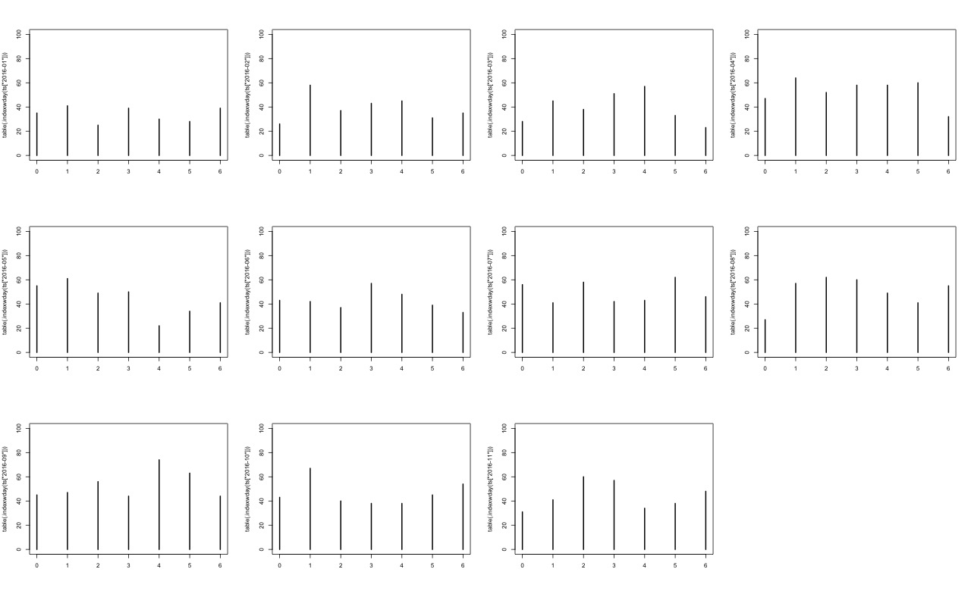
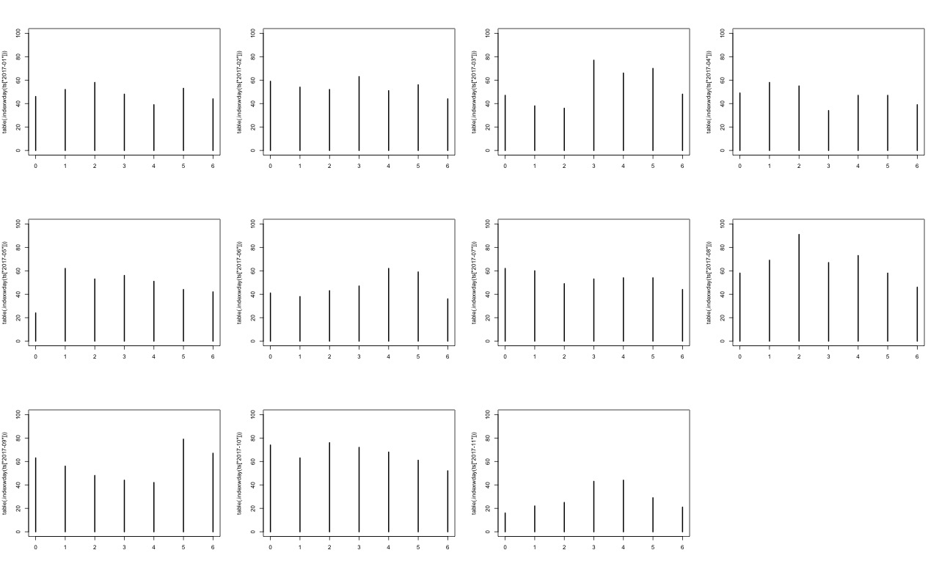
Histogram of Weekday Performance
2016
2017

Slide 11
Use Raw Time Series Data
From the original time series(daily) our forecast looks horizonal, so decide to predict quarterly.

Slide 12
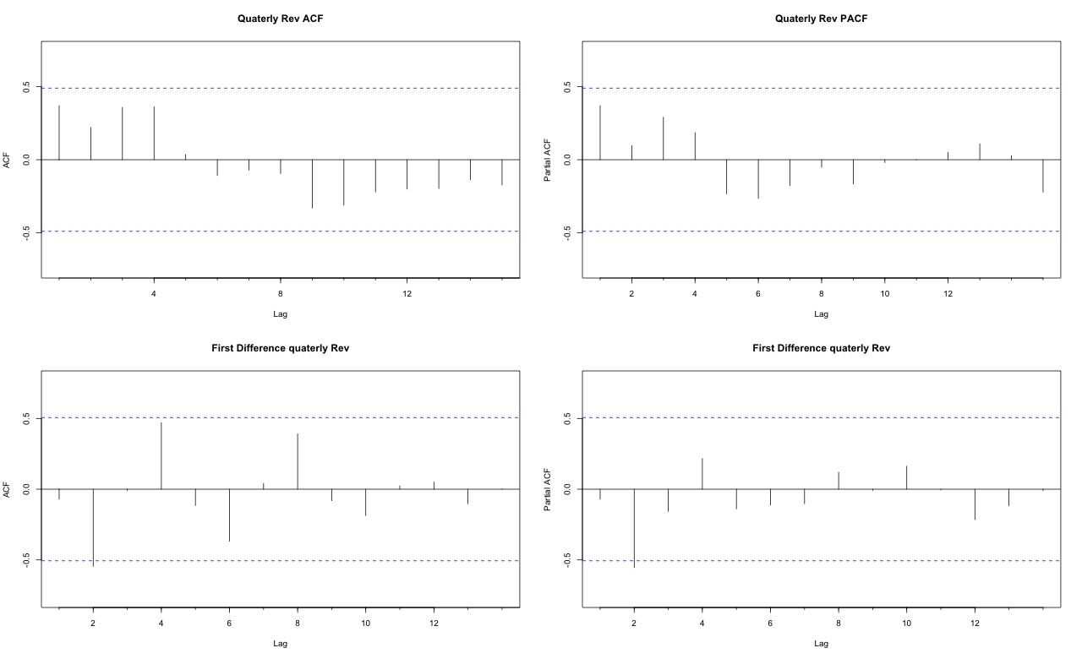
ACF & PACF
The graph shows ACF and PACF are significant in 2.
We choose the model
[2,1,0] [0,1,0]
[0,1,0][1,0,0]

Slide 13
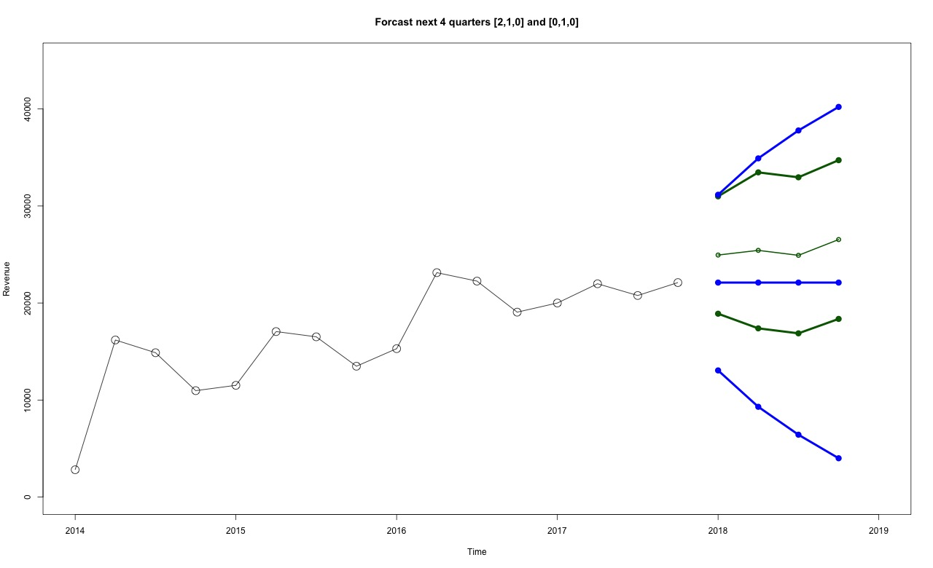
Use Quarterly Summarized Data
ARIMA(2,1,0)
AIC=290.87 AICc=294.87 BIC=293.7
ARIMA(0,1,0)
AIC=297.71 AICc=298.01 BIC=298.41

Slide 14
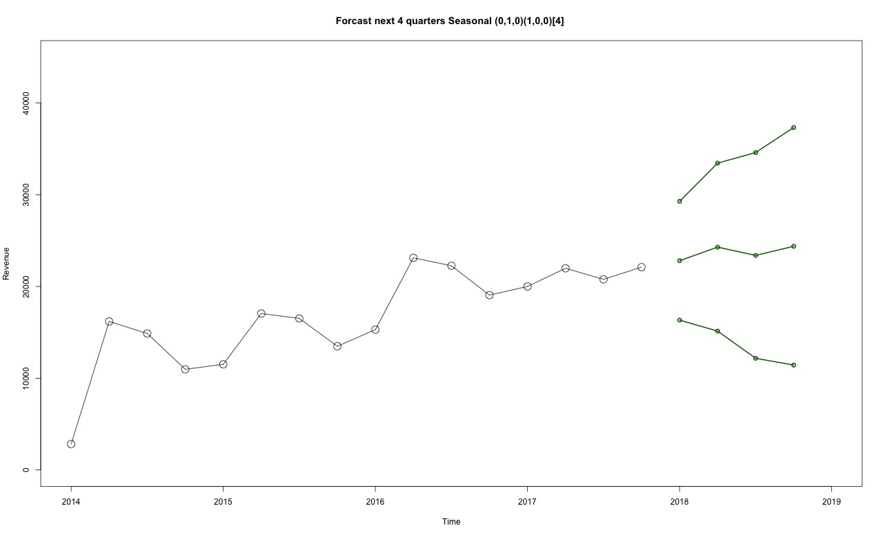
Conclusion
ARIMA(0,1,0)(1,0,0)[4]
AIC=291.88
AICc=292.88
BIC=293.29

Slide 15
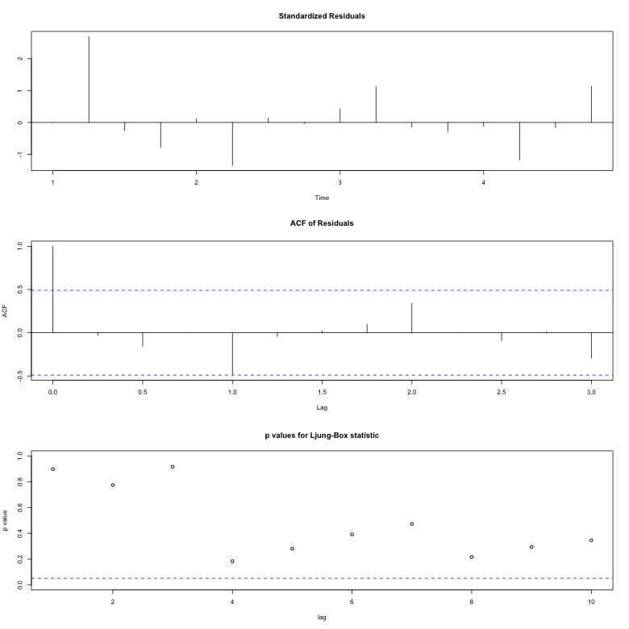
From the diagonal graph, It shows the residual plot and residual ACF. This is the forecast error sample ACF. Since the ACF graph doesn't show spike at larger lag. It indicates that the forecasts would adequately model all of the structure in the data and the sequence of forecast errors would be structureless. Since it is structureless, it is ACF of random data.
The residual data seems white noise since it is not correlated and has a constant variance. The residual graph is more like detrend time series. Ljung-box plot shows the first 10 autocorrelations of the forecast error considered jointly differ from zero beacuse all lag's value is not at the significant level p=0.05. This is a good indication that the forecast errors are white noise.

Slide 16
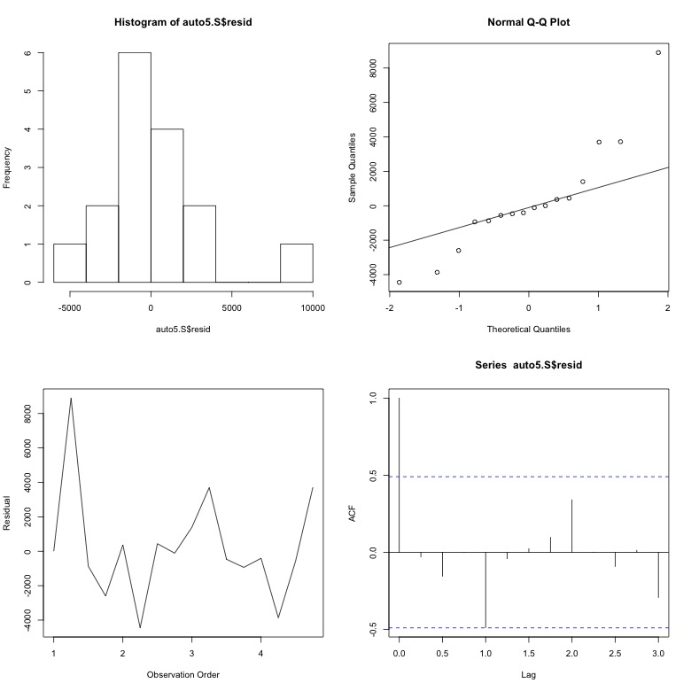
Residual Normality Test
ARIMA[0,1,0]
Shapiro-Wilk normality test
data: auto5.2$redid
W = 0.85453, p-value = 0.01589
ARIMA[2,1,0]
Shapiro-Wilk normality test
data: auto5$resid
W = 0.88879, p-value = 0.0533
ARIMA[0,1,0][1,0,0][4]
Shapiro-Wilk normality test
data: auto5.S$resid
W = 0.88719, p-value = 0.05029
ARIMA[2,1,0]

Slide 17
Conclusion
According to AIC value and Shapiro-Wilk normality test we choose model [2,1,0] to forecast. We test our forecast model and we can predict that histogram and Normal QQ plot seems normally distributed.
We actually did prediction from original data which is very large so we could not get the acceptable results so decided to summarize the data by period, quarterly data. Quarterly data shows better forecast and forecast shows improvement of sales for the next month.

Slide 18
Thankyou

